Slide 1
Architecting Big Data Solutions
Notes:
Suggested introduction:
Faced with _______
We did _______
And discovered_______

Slide 2
Agenda
What is Big Data?
Big Data Ecosystem
Lambda Architecture
Cortana Analytics Suite
Bringing it all together…
Notes:
Our talk today will discuss the challenge with approaching new solutions using traditional models. We’ll discuss the Lambda Architecture and how it addresses a host of new solutions by challenging traditional processes. Finally, we’ll bring it all together with what I hope will be an eye-opening demonstration. At the end of this talk, you’ll have a much better idea about some of the opportunities for Big Data in the cloud.

Slide 3
What is Big Data?
"Extremely large data sets that may be analyzed computationally to reveal patterns, trends, and associations, especially relating to human behavior and interactions" –Oxford Dictionary
When do I need Big Data?
Volume
Velocity
Variety
Notes:
Big Data is a buzz word that is used a lot now days, and can be quite a complex subject. From a high level, I like the definition given here, but let’s discuss the origin of Big Data to give some context on why you care about Big Data. In the past, when working with large data you would scale up your storage and compute power on your database’s machine; however, as companies like Google and Yahoo discovered, you could only go so far where you reach the limits of scaling up and need to spill into other machines and require sharding/partitioning methods. Partitioning can help to a point, but these companies needed a way to have massive parallel processing with thousands of nodes that just wasn’t possible with traditional databases.
Born from a group of people at Yahoo!, an MPP solution called Hadoop allowed for scalable-out compute (MapReduce) and storage (HDFS) on commodity hardware. With Hadoop you could keep adding infinite nodes to your cluster and work could be equally distributed across the system in parallel.
The question is often asked, “When do I need Big Data?”. The answer comes with the three V’s, “Volume”, “Velocity” and “Variety”.
For Volume, if you are dealing with Terabytes or even Petabytes of data the project is usually a good candidate for a Big Data framework. This is due to the need to have a large amount of parallel compute across your cluster in order to work with the data in a reasonable amount of time. Traditional relational database systems become incredibly expensive for clustered environments and many times require custom appliances to run them. Big Data frameworks like Hadoop can run on commodity hardware and are built on open-source software which is freely available.
For Velocity, if you need to ingest thousands to millions of events a second you can use Big Data frameworks (Spark Streaming/Storm) to handle that load and have the same access to all of your data to analyze in near real-time.
For Variety, if you have a diverse set of unstructured data such as log files, documents, video or images, then Big Data frameworks can give you a centralized place to store and process the data with linear compute and storage options.

Slide 4




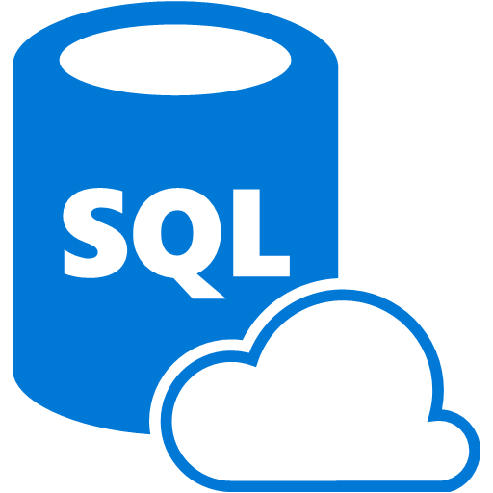


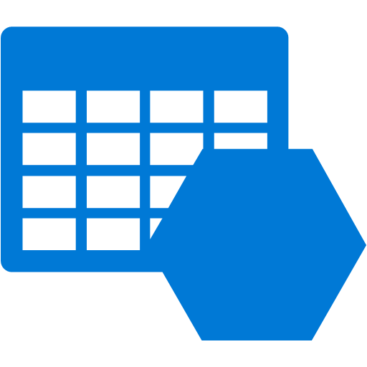








The Old and the New Data Processing
Extract
Transform
Load
OLTP
…
ETL Tool
(SSIS, etc…)
BI Tools
Original data
Transformed data
EDW
(SQL Server, Teradata, etc)
Data Marts
ERP
LOB
Scale-out storage & compute
(HDFS, Blob Storage, etc)
Data Lake(s)
Dashboards
Apps
Ingest
Original data
Streaming data
Transform and Load
Notes:
The problem with EDW in the past is that rules change. If you start to process left to right, this becomes fragile and the data is stale at that point. If you did the rule based on quartiles, you don’t rerun the predecessor. A continued challenge with EDW is limited compute and storage capacity. Traditional analytics projects are notoriously long, complex, and costly. Successful EDW projects can yield tremendous value, and we are not proposing that you discard that value.
Your company has made investments in various tools. You can continue to leverage these tools, even offload the complex processing to cloud to reduce the size of data sets, making those tools more efficient. There are opportunities for new tools that enable new scenarios.
The traditional enterprise data warehouse doesn’t account for the rapidly changing needs of various data sources, and often cannot adapt quickly to accommodate semi-structured or unstructured data. This is where new models such as Hadoop File System coupled with scale-out storage become incredibly valuable. Where traditional warehousing projects are time-consuming and cost in terms of resources, in the cloud, you can spin up an entire new cluster and reprocess the entire past 24 hours of data. You can shut down the cluster when not in use.
Finally, there are new types of data to be processed using streams that differs from the past. We can use technologies to transform and load in near real time to feed analytics solutions.
This is not an either/or proposal. We propose that there’s an opportunity to do both, and this is the benefit of the cloud.

Slide 5
The Big Data Ecosystem
Notes:
Let’s start with the main Big Data players to give context of where lot’s of this started, and then go into what it has evolved to since then.

Slide 6



Major Hadoop Big Data Platforms
Allied Market Research estimates the global Hadoop market to grow from $2 billion in 2013 to $50.2 billion by the year 2020.
Notes:
In the 2004, and engineer named Doug Cutting was the architect of a distributed compute and storage framework called Hadoop. Doug also developed the famous Lucene search technology, which is the core of some famous search frameworks like Elasticsearch and Apache Solr. Over the next few years companies like Cloudera, Hortonworks and MapR emerged with their own distribution of Hadoop and started dominating the market. These companies each have valuations between $1 - $5 billion and are growing in triple digit percentages each year.
So why is this important to Service Integrators? Well according to Allied Market Research, the global Hadoop market is estimated to grow from $2 billion in 2013 to $50.2 billion by the year 2020—that’s a ton of money to be made so if you don’t have skills in the Big Data market you should start learning now.
But why are many companies reluctant to jump into Hadoop? This is partly because the complexity of the Hadoop ecosystem, as shown in the next slide.

Slide 7





Ambari / Cloudera Manager / Cloudera Director
Cluster Management and Monitoring UI
Sqoop
RDBMS Exchange
Spark
SQL / Streaming
Impala
Fast SQL Querying
Pig
Scripting / ETL
Storm
Streaming
HIVE
SQL Language
Oozie
Workflow / Automation
Solr
Search
Mahout
Machine Learning
HBASE
Columnar Store
Hadoop Ecosystem
Zookeeper
HA / Distributed Coordination of Resources
YARN (MapReduce V2)
Yet Another Resource Negotiator / Manager
Flume
Log Collector
HDFS
Hadoop Distributed File System
Notes:
The Hadoop ecosystem is quite complex and has numerous projects that each facilitate a different function. Is it any wonder that people see all the animal names and run away because it’s so much to tackle? It takes some very specialized skills to be able to setup, maintain and optimize a Hadoop cluster. This slide isn’t meant to scare you, but to help you appreciate all the things that go into working with a Big Data framework.

Slide 8

Azure HDInsight
Hadoop in Azure
Massively Parallel Processing (MPP) managed Hadoop cluster
Spark SQL for real-time queries from in-memory caching
Storm and Spark Streaming for near real-time processing of IoT
HBase as a columnar NoSQL transactional database
Hive SQL queries for batch processing
HMaster
Coordination
Name Node
Region Server
Region Server
Region Server
Region Server
Job Tracker
Data Node
Data Node
Data Node
Data Node
Task Tracker
Task Tracker
Task Tracker
Task Tracker
Notes:
In order to simplify the complex framework that Hadoop has become, Microsoft teamed up with Hortonworks to create a fully managed Hadoop cluster in Azure known as HDInsight. HDInsight allows you to specify how many nodes you want, the type of cluster, and whether you want it on Windows or Linux. HDInsight opens up MPP capabilities in the cloud without having to setup your own cluster on-premises or via IaaS. It takes around 1-2 minutes to choose and configure the settings, and then within 15-20 minutes you have a cluster preconfigured and ready to start pushing data into and running distributed queries against in.

Slide 9
When Do I “Do Big Data”
Every project can now benefit
Lowered barriers to entry
Don’t just move on-prem to cloud
Choose projects that make sense
Notes:
Instead of looking at “Big Data” as a big project similar to previous analytics projects that span months or years, every project can now benefit from Big Data concepts to unlock data potential. This is because the on-demand compute model of the cloud combined with scale-out storage in the cloud makes resources available and at a cost unlike ever before.
Don’t look at Big Data projects as something you pick up from on-premises and move, but rather as a new component of a current project. You can now build a public web site and perform analytics on web log data, incorporate social data, and determine customer churn without creating a huge analytics effort afterward. Born-in-cloud data is a great place to start.
Choose projects that make sense. What value do you get of moving your entire Big Data environment to the cloud? Instead, start with new projects. Start with projects that make sense. The key message is that you will realize more value if you don’t try to lift and shift your old environment.
As an example, one customer had a Hadoop cluster on-premises that cost them over a million dollars for all the compute and storage that it required, not to mention all the maintenance the infrastructure required. The customer moved their core process, combining terrabytes of gas meter data and processing it nightly, to HDInsight. The result was a small set of combined data made available in daily increments, and the total solution cost them less than $50K annually. This is just a single example of where Big Data in the cloud makes a lot of sense.

Slide 10
Web Log Processing and Big Data
Notes:
Let’s show an example of using HDInsight to process web logs.
To demonstrate some of the Lambda concepts, we will show how to leverage cold path processing using batching and consuming with existing tools. This demonstration also shows an important point: Big Data doesn’t have to be a project unto itself, it can be part of every project. Our scenario is processing web log data. We will show how easy it is to partition log data from web sites to identify usage per day of our site, and even determine what sites are linking to pages that no longer exist.

Slide 11
Lambda Architecture

Slide 12
Lambda Architecture – High Level View
Batch layer
All data
Precompute views
Batch ingest
Serving layer
Partial aggregate
Partial aggregate
Partial aggregate
New data stream
Merged view
Batch views
Real-time data
Real-time views
Buffered ingest
Speed layer
Process Stream
Increment views
Notes:
The typical Lambda Architecture diagram. There are three layers: Batch, Serving, and Speed.
In the Batch layer, data is ingested. This is the semi-structured or unstructured data sitting in data lakes. Processes are run on this data, maybe as Hive queries that generate map-reduce operations over huge data sets. The result of this compute cycle is a set of views of the existing data that yield answers. Instead of pointing your reporting tool at all of the data for the past 10 years to show the past day of activity, you can process the data to extract the day of data that you are concerned with. This data can now be consumed to answer a business problem.
Opposite of the Batch layer, we have the Speed layer. This is where we process data in near real time. Data is ingested as a stream via a buffer. The stream is processed to create incremental views of data, which is consumed within near real time. This allows you to answer questions like what happened in the past 5 minutes or to monitor for near real time alert and alarm conditions.
This is the high-level view of the Lambda Architecture.

Slide 13

Lambda Architecture – Detailed View
Event Decoration
Event Processing Logic
scoring
Inbound
Data
Buffered
Ingestion
(message bus)
Spooling/Archiving
Hot
Store
Curation
Consumption
Data Movement
/ Sync
Analytical
Store
Notes:
Within the Lambda Architecture, there are additional points to consider.
Starting with the Speed layer, we ingest data but often need to augment or decorate with additional metadata. We might do additional processing such as scoring the data against a machine learning model.
That data is then placed in a hot store where we can quickly take action, such as alerting and events. A hot store might be a queue or notification hub, or even a temporal store that is used for fast processing.
The faster the processing, the more expensive the solution. It takes significant compute resources to process near real time data. This is why you often want to reduce the amount of data in the speed layer (hot path) and move it to the batch layer (cold path).
As we process stream data, we likely want to spool that data to an archival store for additional analytics to be processed as a batch. In the batch layer, we often need to curate data such as data cleansing before we can consume it.
We then consume the data. Note that we are not saying “reporting”, because consumption takes many different forms. We may simply store in a database that is queried by Excel, or there may be an app that connects to the store. It’s not just reports.

Slide 14









Lambda in Azure
Area | Service Offerings | Roll Your Own Offerings
Buffered Ingestion |  | Kafka RabbitMQ
Real-Time Processing |  | Storm on IaaS Spark Streaming
Enrichment |  | Options are Limitless Azure Marketplace 3rd Party Web Services Custom Code
Hot Path Storage |  | Options are Limitless Elasticsearch HBase on IaaS
Cold Path Storage |  | SQL Server in IaaS
Batch Processing / Curation |  | Options are Limitless HDP on Windows in IaaS HDP or CDH on Linux in IaaS
Consumption |  | Excel SSRS Kibana (over Elasticsearch) Tableau
Event Hubs
Service Bus
Storage Queues
Azure Stream Analytics
Storm on HDInsight
Azure Machine Learning
Azure Data Factory
HBase on HDInsight
Azure Blob/Table Storage
Azure SQL Database
HDInsight
Azure Data Factory
Power BI
Notes:
We can easily support the Lambda Architecture in Azure through a set of managed services or by hosting your own offerings in virtual machines. For instance, if you have an investment in Storm or Spark with a custom Hadoop environment, we can accommodate that, but also offer Storm as part of HDInsight as a managed service. Similarly, where you might store data in SQL Server in a virtual machine today, leveraging Azure SQL Database as a managed service reduces your total cost of ownership because you don’t have to manage the servers or patch the applications running on them, you simply consume the data from a service.

Slide 15
Cortana Intelligence Suite
Notes:
Cortana Intelligence is Microsoft’s fully managed intelligent, big data and advanced analytics offering in the cloud, designed to help you transform your data into intelligent action.
It is a comprehensive suite that brings together technologies throughout Microsoft. It provides fast and flexible deployment, with a simple monthly subscription to reduce time and cost challenges.
Cortana Intelligence enables customers to benefit from Microsoft’s investment in the intelligent cloud and advanced analytics, spanning our leading cloud platform with easy to use tools and services that integrate with existing infrastructure and enable enterprises to extend business solutions as their needs grow over time.
With Cortana Intelligence, we are taking years of research and innovation – spanning technology & infrastructure for advanced analytics, including capabilities such as machine learning, big data storage and processing in the cloud, intelligence capabilities like vision, face and speech recognition, and integration with Cortana, Microsoft’s personal digital assistant, with the goal of helping enterprise customers make better, faster decisions to accelerate their speed of business.

Slide 16
Cortana Intelligence Suite Services Transform data into intelligent action
Information Management
Big Data Stores
Machine Learning and Analytics
Intelligence
Data Sources
People
Data Factory
Data Lake Store
Machine Learning
Cognitive Services
Data Catalog
SQL Data
Warehouse
Data Lake Analytics
Bot Framework
Web
Apps
HDInsight
(Hadoop and Spark)
Event Hubs
Cortana
Mobile
Apps
Stream Analytics
Bots
Dashboards & Visualizations
Sensors and devices
Power BI
Automated Systems
Data
Intelligence
Action
Notes:
Cortana Intelligence delivers an end-to-end platform with an integrated and comprehensive set of tools and services to help you build intelligent applications that let you easily take advantage of Advanced Analytics and intelligence capabilities.
First, Cortana Intelligence provides services to bring data in, so that you can analyze it. It provides information management capabilities like Azure Data Factory so that you can pull data from any source (relational DB like SQL or non-relational ones like your Hadoop cluster) in an automated and scheduled way, while performing the necessary data transforms (like setting certain data columns as dates vs. currency etc). Think ETL (Extract, Transform, Load) in the cloud. Event Hubs does the same for IoT type ingestion of data that streams in from lots of end points.
The data brought in then can be persisted in flexible big data storage services like Data Lake Store and Azure SQL Data Warehouse.
You can then use a wide range of analytics services from Machine Learning to Azure Data Lake Analytics to Azure HDInsight to Azure Stream Analytics to analyze the data stored in the big data storage. This means you can create analytics services and models specific to your business need (say real time demand forecasting).
The resultant analytics services and models created by taking these steps can then be surfaced as interactive dashboards and visualizations via Power BI.
These same analytics services and models created can also be integrated into various different UI (web apps or mobile apps or rich client apps), or with Cortana, so end users can naturally interact with them via speech etc., and so that end users can get proactively be notified by Cortana if the analytics model finds a new anomaly (unusual growth in certain product purchases- in the case of real time demand forecasting example given above) or whatever deserves the attention of the business users. Similar integration can occur with Cognitive Services or Bot Framework based applications.
At a high level though, Cortana Intelligence capabilities are in three main areas: data, analytics and intelligence.
<Transition>: We’re going to dive into each one, starting with data.

Slide 17




Cognitive Services Give your solutions a human side
Vision
Speech
Language
Knowledge
Search
Computer Vision
Speaker Recognition
Text Analytics
Academic Knowledge
Bing Search API
Face
Speech
Bing Speller
Entity Linking Service
Bing Image Search API
Emotion
CRIS
Web Language Model
Knowledge Exploration Service
Bing Video Search API
Video
Linguistic Analysis
Recommendations
Bing News Search API
Language Understanding Intelligent Service
Bing Auto Suggest API
Notes:
Cognitive Services are available individually or as a part of the Cortana Intelligence Suite, formerly known as Cortana Analytics, which provides a comprehensive collection of services powered by cutting-edge research into machine learning, perception, analytics and social bots.
Microsoft Cognitive Services, a set of cloud services, APIs and SDKs that enable organizations to build intelligent systems that can see, hear, interpret and understand the world around you and makes all applications more intelligent, engaging and discoverable. Cognitive Services expands the existing perceptual intelligence capabilities like Vision, Speech, Text and Face detection to include new cognitive capabilities such as Emotion and customized Language Understanding. What we showcased with www.how-old.net is one example of what is possible.
Developers and businesses can use this suite of services and tools to create apps that learn about our world and interact with people and customers in personalized, intelligent ways.
Faces, images, emotion recognition and video intelligence
Spoken language processing, speaker recognition, custom speech recognition
Natural language processing, sentiment and topics analysis, spelling errors
Complex tasks processing, knowledge exploration, intelligent recommendations
Bing engine capabilities for Web, Autosuggest, Image, Video and News

Slide 18
Bot Framework
Your Bot Framework Bot
Bot Connector
Bot Builder SDKs
Bot Directory
Connect your bot(s) to text/sms, Office 365 mail, Skype, Slack, Twitter, and other services.
Build great dialogs within your Node.js- or C#-based bot
COMING SOON - Try, use, and add published bots to the world’s top conversation experiences
Register, connect, publish and manage your bot through the bot dashboard
Message routing
Automatic translation to 30+ languages
User and state management
Embeddable web chat control
Debugging tools
Open source SDK on Github
From simple built-in prompts and command dialogs to simple to use yet sophisticated ‘FormFlow’ dialogs
Libraries, samples and tools to make a great conversationalist
Chat emulator
Leverage related services available in Cognitive Services
Public directory of bots registered and approved with Bot Framework
Users can try your bot from the directory via the web chat control
Users can discover and add your bot to the channels on which it is configured
Notes:
Bot Framework provides everything you need to build and connect intelligent bots that interact naturally wherever your users are talking, from text/sms to Skype, Slack, Office 365 mail and other popular services.
Bot Framework consists of three main components: Bot Connector, Bot Builder, and Bot Directory

Slide 19

Cortana
Here are some of the things I can help you with…
Cortana for Consumers (today)
With the Cortana Intelligence Suite
Answers
Public reference data answers – “How far is it from Los Angeles to San Francisco?”
Answers from organizational data in Power BI
“What were our biggest deals that closed last month?”
Predictions
Event predictions – “Who do you think is going to win the Germany Italy game?”
Integration with prediction solutions
“Which of our customers are most likely to churn in the next quarter?”
Monitoring & Alerts
Flight status, traffic conditions, changes in weather, …
Monitoring KPIs and preemptive alerting
“Alert me if this customer ever has a 90% chance of churn in the next 30 days”
Task Completion
Setting reminders, scheduling meetings, getting directions, …
Line of business process integration
Assistance with expense report submission on-time within policy
Notes:
The Cortana Intelligence Suite integrates with Cortana, Microsoft’s digital personal assistant. Cortana works with the suite to enable your business, and or your customers business, to get things done in more helpful, proactive, and natural ways. Building on years of Microsoft’s research and innovation in perceptual intelligence including speech recognition, natural user interaction, predictive and advanced analytics, Cortana brings the capabilities of a personal digital assistant to business.

Slide 20
Cortana Intelligence Suite Licensing
TBD

Slide 21
Bringing it all together… connected cars scenario
Notes:
Rather than demo all of these services individually, let’s look at a scenario. Our “connected cars” scenario will bring together many parts of the Cortana Analytics Suite together to solve a real world problem.
There are many opportunities surrounding connected cars. Usage-based insurance is starting to appear today, just plug in a dongle into your car and lower your rates. Manage entire fleets for optimal routes and respond quickly to potential alert conditions. These are just a few of the business opportunities that are transforming the auto industry.
Connected car technology is split between two approaches
Put the Internet connection in the car (embedded connections)
Does not require a phone data plan to operate
Provides access to more features and data
Rely on a secondary device
Embedded connections win, because auto companies will be able to
Collect data on the performance of cars
Send updates and patches to cars remotely
Avoid recalls related to the car's software

Slide 22



Solution Architecture
Data
Ingest
Prepare
Analyze
Consume
Publish
Azure ML
Event Hub
Stream Analytics
Event Hub
Custom Dashboard Application
Data in motion
Power BI Dashboards
Data at rest
HDInsight
HDInsight
Azure ML
SQL Data Warehouse
Blob storage
Vehicle catalog
import
Data Factory: Move data, orchestrate, schedule, and monitor
Notes:
Our solution will have a car that is connected to the internet and ingests telemetry data to an Event Hub.
The data is read from the Event Hub using an Azure Stream Analytics job that outputs the data to a second Event Hub. This is done to summarize time series data. A custom dashboard application reads from the second Event Hub, enriches data using Azure ML scoring, and pushes to Power BI Dashboards for real-time visualizations. Stream Analytics also pushes the data to blob storage and a SQL Data Warehouse for analytics consumption.
The solution imports vehicle catalog data into Azure blob storage. We now want to process this using Hadoop, but don’t want to create and manage the virtual machines for the cluster. We will instead use HDInsight, a managed service that provides a scalable Hadoop installation as a service.
Rather than create an HDInsight cluster and manage the batch process scheduling ourselves, our system will instead leverage Azure Data Factory to dynamically spin up a new HDInsight cluster to prepare the data. If you have an existing cluster, you can bring your own as well. The cluster is provisioned with a “time to live” parameter.
One of the most interesting parts of the solution is the use of AzureML to detect anomalies. Azure Data Factory connects to an AzureML endpoint to score the likelihood of repair work or recalls based on anomalies detected in the data.
Finally, the data factory will move data to the Azure SQL Data warehouse, where it can be consumed from Power BI dashboards.

Slide 23
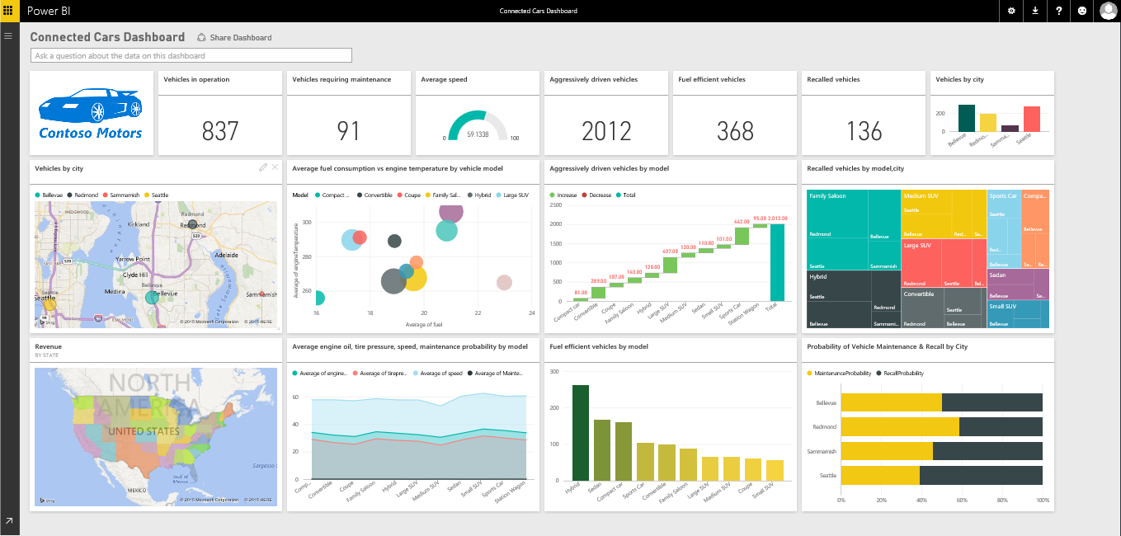
Power BI Dashboard
Notes:
The solution uses a Power BI dashboard that leverages data from the SQL Data Warehouse and real-time data from Azure Stream Analytics.

Slide 24
Connected Cars and Cortana Analytics Suite

Slide 25
Summary
Comprehensive offer for our Big Data and AA cloud portfolio
Enables a broad class of business specific scenarios
Integrates with investments in Perceptual Intelligence & Cortana
Customers can get going in individual services today
Available to transact this fall as a simple monthly subscription
Pricing and included quantities are still TBD

Slide 28
From Data to Decisions and Actions
Data
Recommendations
What should I do?
Decision
Action
Decision automation
Decision support
Predictions
What will happen?
Interactive dashboards
Why did it happen?
Static reports
What happened?
Manual process
Value

Slide 29

Cortana Analytics Suite Transform data into intelligent action
Business apps
People
Custom apps
Cortana Analytics
Sensors and devices
Automated Systems
DATA
INTELLIGENCE
ACTION

Slide 30

Cortana Analytics Suite Transform data into intelligent action
Preconfigured Solutions
Dashboards and Visualizations
Machine Learning and Analytics
Big Data Store
Information Management
Personal Digital Assistant – Cortana
Perceptual Intelligence

